Slide 1



BLOCKCHAIN
BLOCK CHAIN IN SUPPLY CHAIN MANAGEMENT
Title: Blockchain in Supply Chain Management
Roll No: 23 (T.E-comp, Div-A)
Name of Student: Nikhil Babasaheb Jagtap
Name of Guide: Shobha Bamane Ma’am

Slide 2


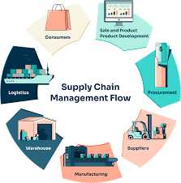
Introduction
Definition of Blockchain:
Blockchain is a decentralized, distributed ledger technology that records transactions across many computers in such a way that the registered transactions cannot be altered retroactively. This ensures transparency and security.[1]
Importance in Supply Chain Management:
Supply chains are complex networks involving multiple stakeholders, including suppliers, manufacturers, distributors, retailers, and customers. Inefficiencies such as delays, fraud, and lack of visibility can lead to significant financial losses.
Blockchain technology addresses these issues by providing a transparent and secure method for tracking products and transactions throughout the supply chain.[2]

Slide 3
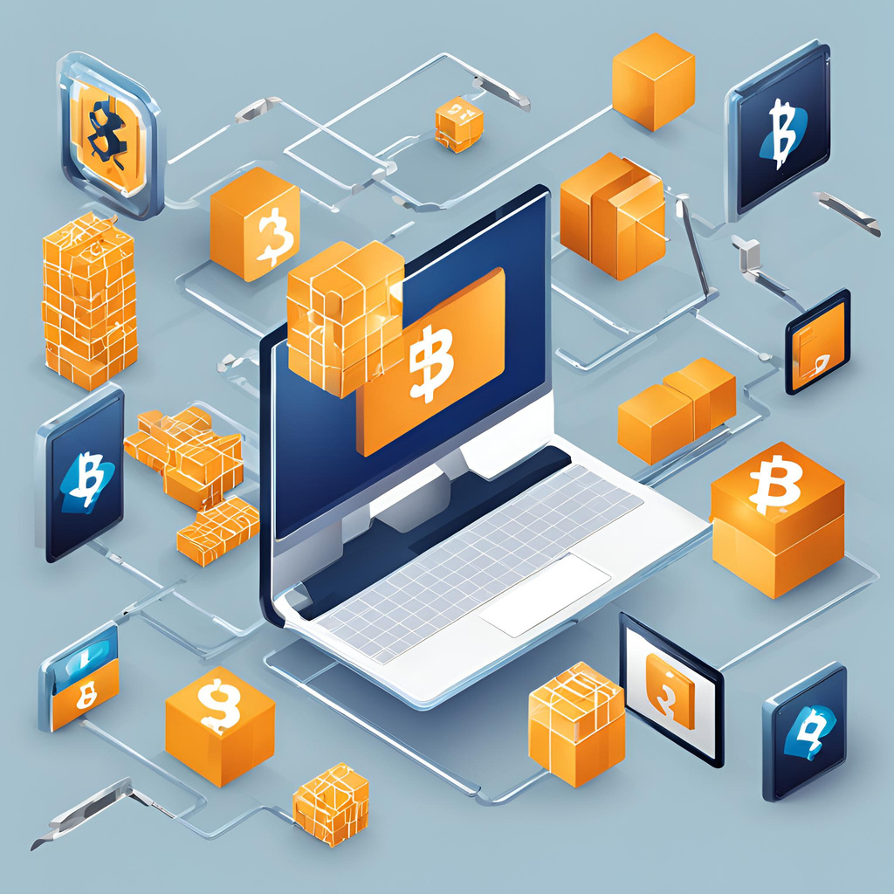
AIMS & OBJECTIVES
Aim:
To analyze how blockchain technology can be integrated into supply chain management to enhance efficiency, transparency, and security.
Objectives:
Identify and assess current supply chain challenges.
Explore how blockchain can address these challenges.
Examine real-world implementations of blockchain in supply chains.
Evaluate the potential advantages and disadvantages of blockchain adoption.

Slide 4
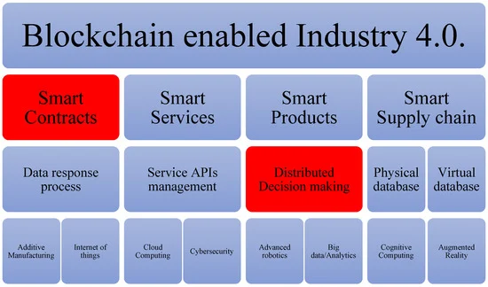
SYSTEM ARCHITECTURE
Figure 1. Industry 4.0 architecture based on blockchain. (The red elements represent the impact of integrating blockchain in the architecture of Industry 4.0.) [4]

Slide 5
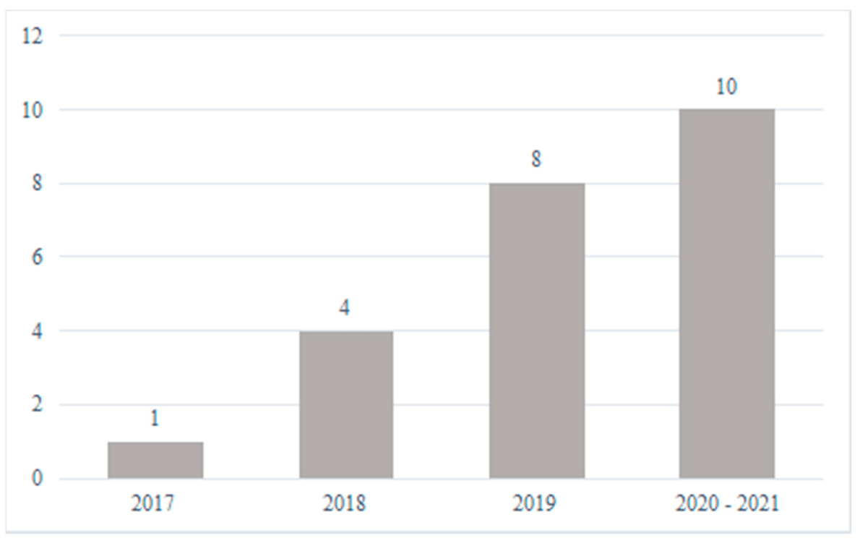
ADVANTAGES OF BLOCKCHAIN IN SUPPLY CHAIN
1 | Transparency: | Every transaction is recorded and visible to all authorized parties. This reduces information asymmetry and increases accountability.
2 | Traceability: | Blockchain allows the tracking of products at every stage, from production to delivery, which is especially important for industries like food and pharmaceuticals.
3 | Efficiency: | Automation through smart contracts reduces the need for intermediaries, thus reducing processing times and human error.
4 | Security: | Blockchain's cryptographic nature ensures that data cannot be altered or tampered with once recorded, providing a secure and reliable audit trail.
Figure : Bar chart showing the impact of blockchain on supply chain efficiency, transparency, and security.[2]

Slide 6
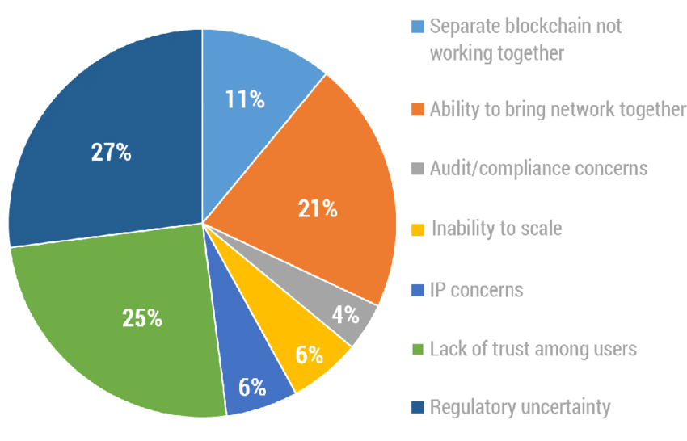
ADVANTAGES OF BLOCKCHAIN IN SUPPLY CHAIN
1 | High Initial Costs | The cost of implementing blockchain systems, including infrastructure and training, can be prohibitive for many organizations.
2 | Scalability Issues | As more transactions are added to the blockchain, some systems struggle to handle high volumes without slowing down.
3 | Lack of Standardization | There are currently no universally accepted standards for blockchain technology, making it challenging to implement across diverse supply chains.
4 | Regulatory Concerns | Many governments and organizations are still uncertain about how blockchain fits into existing legal and regulatory frameworks.
Figure : Pie chart showing common barriers to blockchain adoption (e.g., costs, scalability, regulatory concerns). [4],[5]

Slide 7
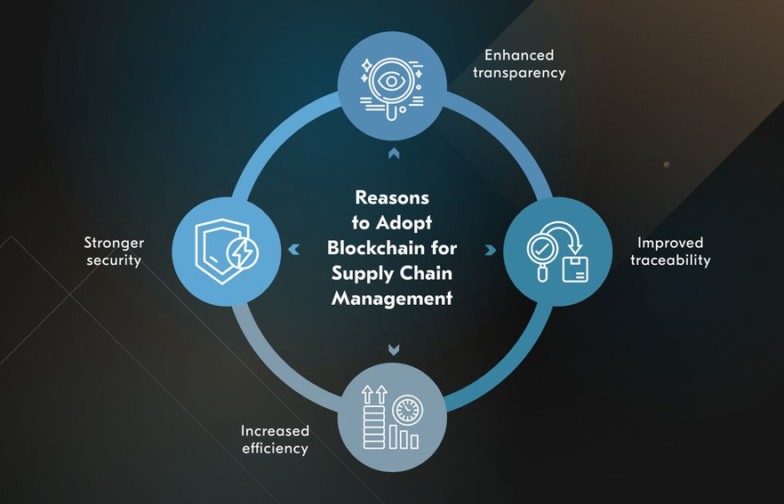
CONCLUSION
Summary:
Blockchain is a powerful tool for enhancing transparency, security, and efficiency in supply chains.
Despite its advantages, challenges like cost, scalability, and regulatory hurdles need to be addressed for widespread adoption.
Industries that rely heavily on transparency and trust (e.g., food safety, pharmaceuticals) are likely to see the greatest benefits .

Slide 8

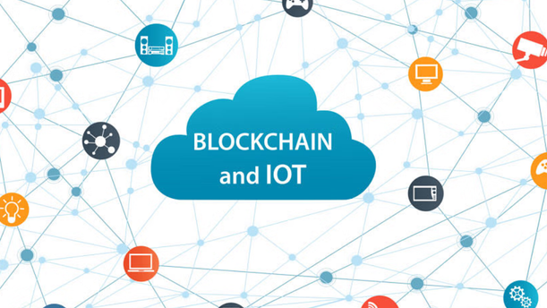
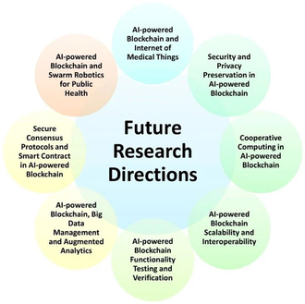


FUTURE SCOPE
IoT and Blockchain Integration:
Research Directions:
Industry-Specific Solutions:
Blockchain and Artificial Intelligence (AI):
The future of blockchain in supply chains may include integration with the Internet of Things (IoT) to enable real-time monitoring of goods during transport.
Ongoing research on new consensus algorithms (e.g., Proof of Stake) to improve scalability and reduce energy consumption.
Exploring government regulations to create a standardized blockchain framework .
Blockchain solutions tailored to specific industries (e.g., agriculture, healthcare) are expected to emerge.
Combining AI with blockchain can enhance supply chains by automating decisions and predictive analytics. AI analyzes blockchain data to optimize inventory, forecast demand, and assess supplier performance.

Slide 9
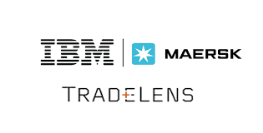
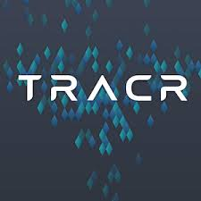
Case Study 1: Maersk and IBM – TradeLens
Overview: Maersk partnered with IBM to create TradeLens, a blockchain-based platform for global shipping.
Blockchain Role: Provides real-time data sharing among shipping companies, ports, and customs.
Results: Reduced paperwork, improved tracking, and increased transparency across supply chains.
Impact: Adopted by over 100 organizations, reducing delays and improving collaboration.[5]
CASE STUDY
Case Study 2: De Beers – Tracr
Overview: De Beers developed Tracr, a blockchain platform to track diamonds from mine to consumer.
Blockchain Role: Verifies diamond provenance, ensuring authenticity and ethical sourcing.
Results: Improved transparency, reduced counterfeit risks, and increased consumer trust.
Impact: Revolutionized diamond supply chains by ensuring responsible sourcing.[5]

Slide 10

REFERENCES
1.Nakamoto, S. (2008). Bitcoin: A Peer-to-Peer Electronic Cash System. Retrieved from bitcoin.org
4. Xie, J., & Wu, D. (2020). "Blockchain Technology in the Logistics and Supply Chain Management."
2. Kshetri, N. (2018). "1 Blockchain's Roles in Meeting Key Supply Chain Management Objectives." International Journal of Information Management, 39, 80-89.
5.Tapscott, D., & Tapscott, A. (2016). Blockchain Revolution: How the Technology Behind Bitcoin Is Changing Money, Business, and the World.
3. Wang, Y., Gunasekaran, A., & Ngai, E. (2016). "Big Data in Logistics and Supply Chain Management."

Slide 11


Connect with us.
Email
jagtapnikhil2411@gmail.com
Call us
9503311351
Thank You..

